Slide 1
From Frontlines to Lifelines: How reducing cybercrime would make life healthier for us all
Stephen Cobb, CISSP
Freelance Researcher
Notes:
Title page for my talk at Cyberhagen 2024 in September 2024.
A link to slides will appear in my Link Tree: https://linktr.ee/StephenCobb

Slide 2
THE BIG PICTURE
Reducing cybercrime will make life healthier for us all
Realizing this creates opportunities to elevate the cybersecurity narrative
Why?
Because exposure to cybercrime is harmful to humans and hard to avoid
Doing better at cybersecurity and cybercrime deterrence reduces healthcare costs and improves lives
Notes:
The main assertions of the talk in four points

Slide 3
Not my first time speaking in Copenhagen
1996-1997 was a busy time for IT security
Network 97 Conference, Copenhagen, April, 1997
Guest speaker: What Firewalls Do and Don't Do
Firewalls and Internet Security Conference, D.C. January, 1996: Introduction to Firewall Security Policies
Internet Technology Conference, Hong Kong, January, 1996, Seminar: Security Implications of Internet Commerce
National institute of Health, February, Baltimore, 1996, Seminar: Security Risks of Internet Commerce
Insurance Industry and the Internet Seminar, New York, June, 1996, Seminar: Internet Security Risks
Firewalls West Conference, Los Angeles, July, 1996, Presentation: Firewall Policy Guidelines
Financial Securities Marketing Seminar, New York, April, 1997, Seminar: Internet Risks
Network 97 Conference, Copenhagen, April, 1997, Guest speaker: What Firewalls Do and Don't Do
National Association of Federal Credit Unions Conference, Miami, May 1997, Presentation: Security Risks in Internet Banking
CyberSecurity 97, Hong Kong, May, 1997, Conference Chairperson and Keynote Speaker: Internet security in the corporate environment: what's in store for the future
CyberSecurity 97, Tokyo, July, 1997, Conference Chairperson and Keynote Speaker: Internet security in the corporate environment: what's in store for the future
Notes:
From January 1996 to July 1997, I spoke at 10 conferences

Slide 4
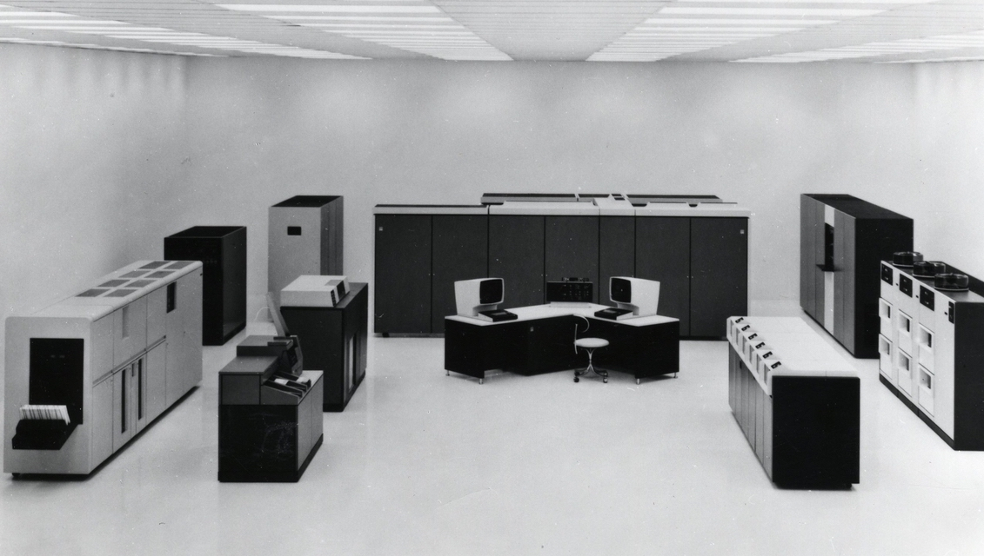
Multiple frontlines, evolving over time
1982 IBM PC
64 KB RAM, DISPLAY
2 x 320KB DRIVES
DOT MATRIX PRINTER
PRICE: $3,480
IN TODAY’S MONEY
$11,343
1980
IBM 3033 MAINFRAME
Notes:
The IBM PC was small enough to steal, and pricey enough to motivate thieves, validating the predictions of Felson and Cohen and their Routine Activity Theory of crime: Crime happens convergence of motivated offender, suitable target, absence of capable guardian.
An IBM PC with a monitor, two floppy disk drives, and a printer in 1982 would have cost approximately $3,480. This was a considerable amount of money at the time, equivalent to about $11,000 today, adjusted for inflation.
The storage capacity of a 5.25 inch floppy disk back then, with version 1.0 of PC DOS (1981), was 160 KB on one side. DOS 1.1 in 1982 allowed storage on both sides of the disk = 320 KB. In 1983, DOS 2.0 supported 360 KB on a double-sided.

Slide 5
Multiple frontlines, evolving over time
IBM PC takes world by storm – Cobb’s Guide to PC & LAN Security (1992)
Internet takes world by storm – Firewall articles, classes (1996)
E-commerce takes world by storm – Whitepapers, seminars (1996)
Demand for cybersecurity skills surges – Founded a cybersecurity startup
Demand for data privacy skills surges – Founded a data privacy startup
Fear of cybersecurity skills gap grows – MSc dissertation (2016)
Digitally enabled fraud skyrockets – Study cause and effects of cybercrime
Left ESET in 2019, became carer, researching digital fraud’s personal impact
Basically, 30 years urging people to take cybersecurity and cybercrime a lot more seriously than they have so far
Notes:
Selected list of “frontlines” on which I have worked.

Slide 6
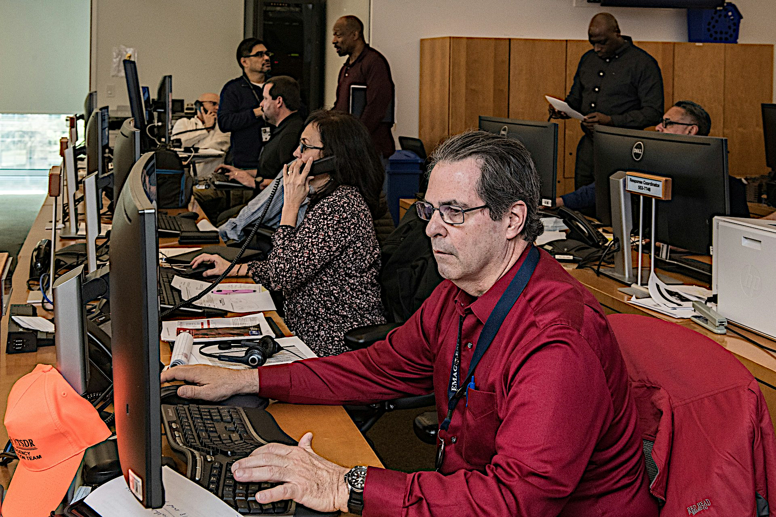
Notes:
Information System Security frontline: Network Operations Center

Slide 7
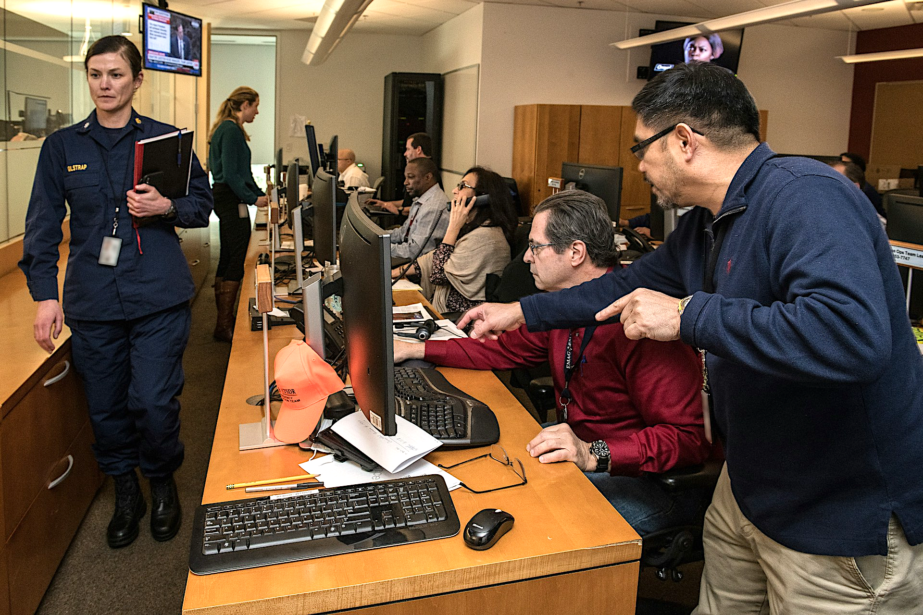
Notes:
Anomaly detected in Network Operations Center

Slide 8
Notes:
Incident escalated to Security Operations Center

Slide 9
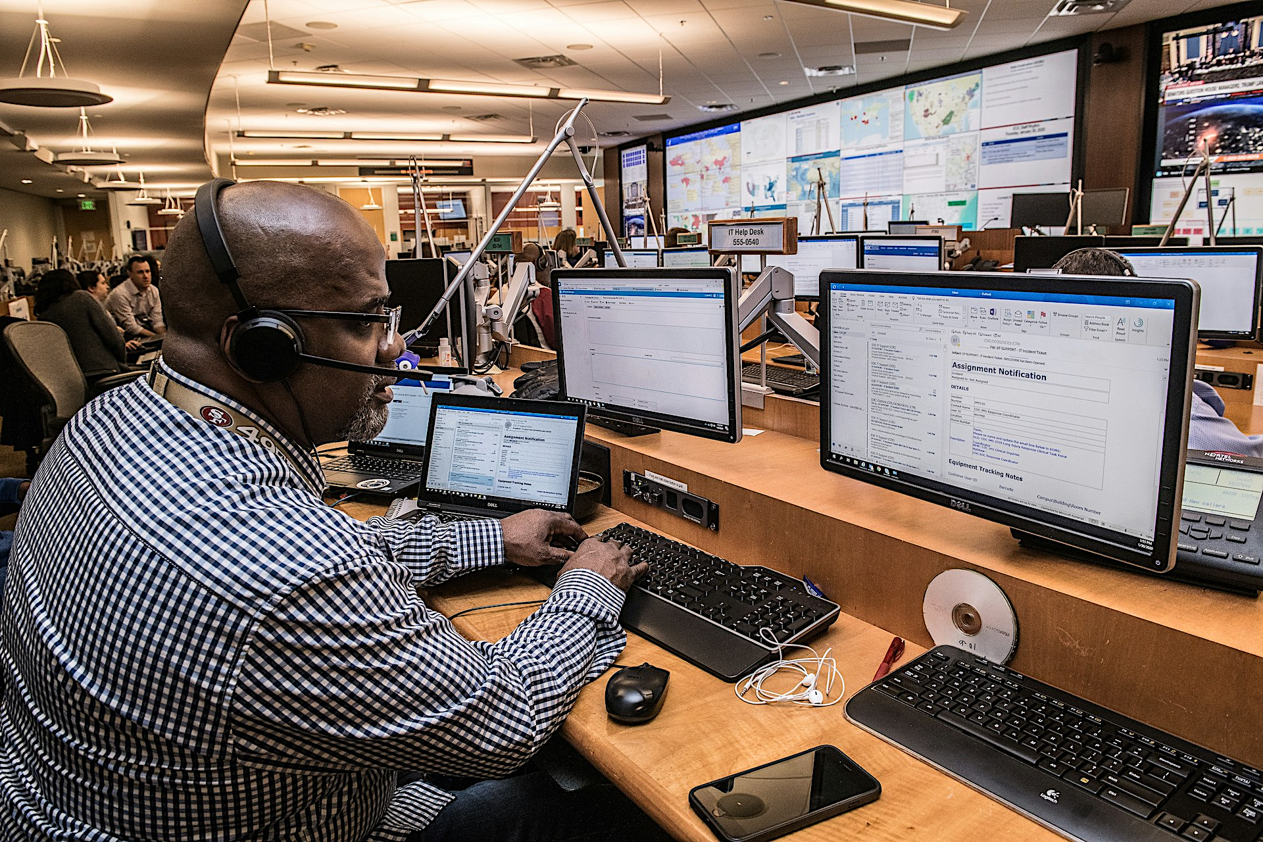
Notes:
Responding to a breach/attack

Slide 10
Notes:
Security frontline becomes cybercrime frontline as breached data fuels digitally-enabled scams and fraud.

Slide 11
In the UK you are more likely to be a victim of fraud than any other crime
Fraud now accounts for 41% of all UK crime against individuals, most of it online
In the US, scam attempts by phone, email and text have grown so pervasive, two-thirds of Americans say they are at a crisis level
Notes:
UK government statistics, US AARP

Slide 12
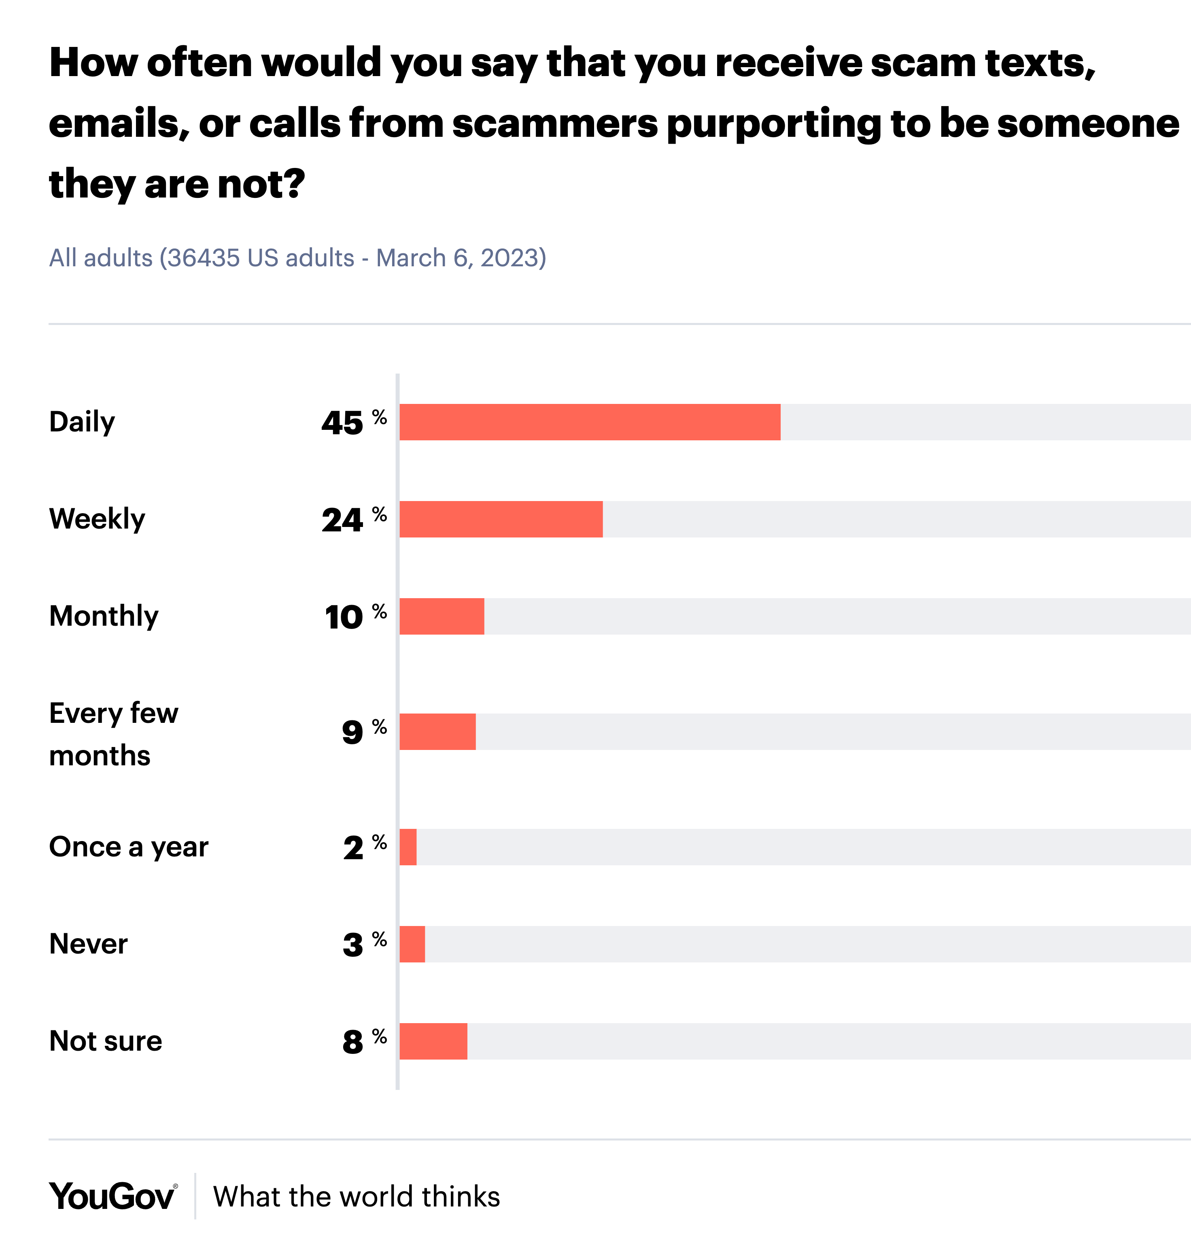
Notes:
Stats from YouGov

Slide 13
In the last 12 months, 41% of Danes experienced an increase in scam encounters
In 2023, scams siphoned off US$2.82 billion, equal to 0.7% of Denmark's GDP
19% of individuals approached by scammers end up losing money
Average amount lost? US$3,067
38% of victims experience a profound emotional impact…psychological distress and feelings of betrayal can inflict a deep, long-lasting impact on those they affect
Financial losses from scam attacks increased by 150% between H2 2022 and H1 2023
What about Denmark?
Notes:
Global Anti-Scam Alliance (GASA), in partnership with BioCatch: https://ebrand.com/blog/online-scams-in-denmark-new-report-reveals-the-latest-trends/

Slide 14
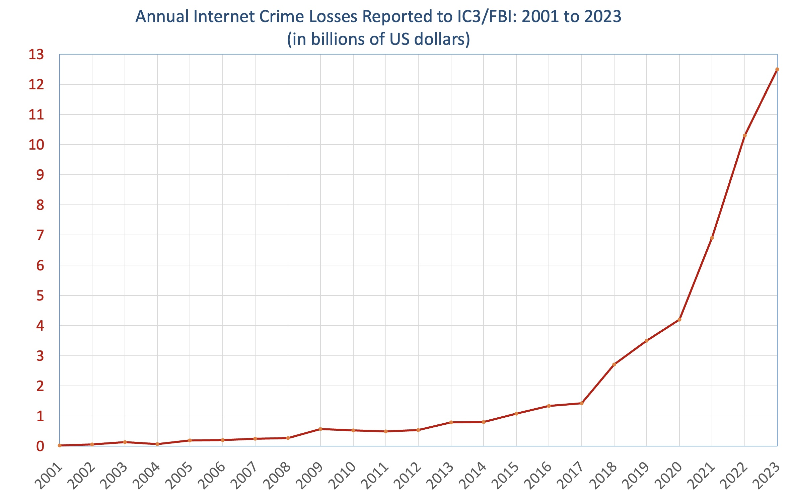
The Growth Curve of Internet/Online Crime in the US
Measured in dollars lost
10X growth in 7 years
2015 to 2022
Notes:
My IC3 chart

Slide 15
Internet-online-digital-e-crime is rising, as is awareness that it causes harm that goes beyond monetary losses
The Ransomware Victim Experience, a study of personal harms, by the UK’s Royal United Services Institute (RUSI)
IT teams were overworked, stressed, suffered from PTSD-like symptoms, even hospitalized after an attack
It's All Over but the Crying: The Emotional and Financial Impact of Internet Fraud — David Modic and Ross Anderson, 2015
“Internet fraud’s emotional impact is a major component of victimization and felt as strongly as the financial impacts”
Social value and life satisfaction research by UK consumer advocate Which? valued average fraud victim loss of wellbeing:
General fraud $3,300 — More than average monetary loss
Online fraud : $4,818 — 46% higher than offline
Notes:
Social value studies: “Following best-practice guidance from HM Treasury … and using an unbiased estimate of the impact of income on one’s life satisfaction (Fujiwara & Dass, 2021).”
The Simetrica-Jacobs-Which research strongly indicates that “the average fraud victim would require £2,509 to compensate them for the loss in wellbeing that’s associated with being scammed.”
Mental Health: The Importance of Resilient Cyber Leaders (N)
Camilla Treschow Treschow&Son

Slide 16
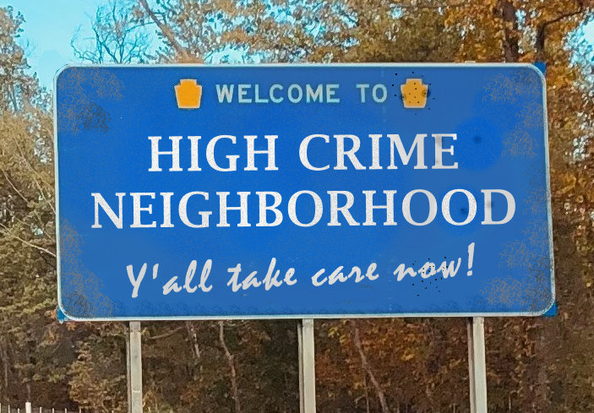
But it’s even worse than that…
Crime can cause you harm even if you’re not directly victimized
Just being exposed to crime is mentally and physically harmful
Plenty of evidence of this in the offline world
Google+Scholar “High Crime Neighborhood”
Researchers from criminology, epidemiology, environmental health and exposomics
Have documented negative health effects of exposure to traditional “offline” crime
Notes:
Associations between dimensions of the social environment and cardiometabolic risk factors: Systematic review and meta-analysis
Abreu et al., 2024, Netherlands
SSM - Population Health

Slide 17
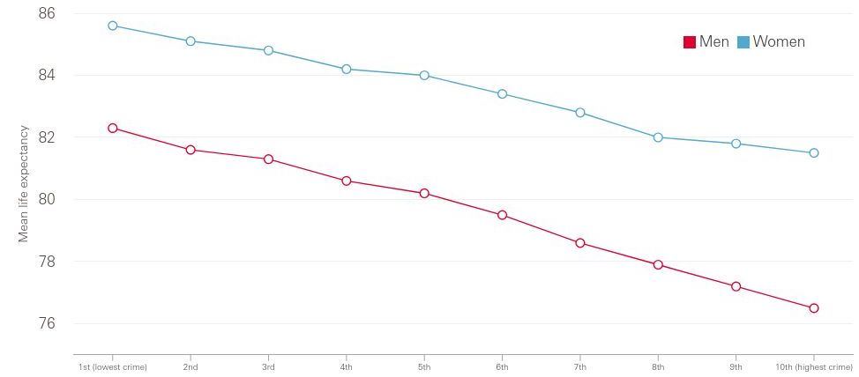
People tend to live shorter lives if they live in neighbourhoods with higher crime rates
(Life expectancy for men and women by neighbourhood crime rate decile: England, 2023)
Notes:
Source: Health Foundation analysis of Police UK, street-level crime data, England, 2023; Office for National Statistics, Life Expectancy at Birth for Middle layer Super Output Areas (MSOAs), England, 2016–20; Office for National Statistics, Mid-Year Population Estimates for Middle layer Super Output Areas, UK, 2020
Note: Greater Manchester and Devon & Cornwall Police Force Areas have been excluded from the analysis as they have not provided 2023 data.

Slide 18
Heart problems in high crime neighborhoods
“…the association between short-term burglary rate change and CRP levels was non-trivial for men, offering evidence that stressful changes in the environment may have important implications for inflammatory processes related to cardiovascular health.”
Neighborhood stressors and cardiovascular health: Crime and C-reactive protein in Dallas, USA
Browning et al. 2012, US
Social Science & Medicine
Notes:
“Beyond the immediate and often tragic results of crime for victims and their families, crime has broader negative implications for residents of urban neighborhoods who must negotiate potentially dangerous environments. Although challenging to investi- gate, evidence of environmental stress effects on a variety of health outcomes is mounting. Uncovering the processes by which crime and other sources of environmental stress shape inequalities in health will be an important next step in the ongoing effort to remedy pervasive social inequities in population health”

Slide 19
High crime neighborhoods are fattening
“…an average male of 1.8 meters [5 feet 11 inches] living in a high crime neighborhood would be 6.35 kilograms [14 pounds] heavier than a male living in a low crime neighborhood.”
Associations of Perceived Neighborhood Safety and Crime with Cardiometabolic Risk Factors Among a Population with Type 2 Diabetes
Tamayo et al. 2016 US
Health Place

Slide 20
Denmark has its own studies
“Study results suggest that refugees who were assigned to more disadvantaged neighborhoods were more likely to develop hypertension, hyperlipidemia, diabetes, and myocardial infarction in subsequent decades.”
Association of Neighborhood Disadvantage With Cardiovascular Risk Factors and Events Among Refugees in Denmark
Hamad et al. 2020 Denmark
Global Health
Notes:
[This study took advantage of a unique natural experiment in which refugees to Denmark were assigned to neighborhoods with different levels of socioeconomic disadvantage. From 1986 to 1998, the Danish government dispersed tens of thousands of incoming refugees across the country in an arbitrary fashion, conditional on observed characteristics, to avoid overcrowding in major cities. We employed unique population-level data spanning 3 decades from Denmark’s population and health registers. We tested the hypothesis that neighborhood socioeconomic disadvantage is associated with increased risk of CVD risk factors, myocardial infarction, and stroke across the life course among resettled refugees.]

Slide 21
Neighborhood crime impacts mental health
“our results suggest that the effect of [local area] crime on mental health are quite large, relative to the effects of other covariates.
Locus of control and the mental health effects of local area crime
Churchill and Smyth, 2022, Australia
Social Science & Medicine
“We find that local crime rates have a significant, negative, and substantial effect on mental well-being in urban areas … We conclude that the effects of local crime on mental distress of citizens are large, with possibly significant economic costs.”
The effect of local area crime on mental health
Dustmann and Fasani, 2016, UK
The Economic Journal

Slide 22
Higher crime = more cardiometabolic risk
“The present study provides novel evidence that objective neighbourhood crime rates among men, and perceptions of neighbourhood crime among women, are related to clinically-measured cardiometabolic risk … higher levels of crime and less safety was associated with higher risk of cardiometabolic risk factors.”
Gender-specific associations between perceived and objective neighbourhood crime and metabolic syndrome
Baldock et al. 2018, Australia
Public Library of Science
Notes:
[cardiometabolic risk conditions like metabolic syndrome, a clustering of factors (including for instance obesity, high blood pressure and dyslipidaemia) predictive of cardiovascular and metabolic diseases]
…The results confirm the importance of including objective and perceived measures of environmental expo- sures, in this case crime, when examining relations with health outcomes…Social policy and public health strategies targeting crime reduction, as well as strategies to increase perceptions of safety, have potential to contribute to improved cardiometabolic outcomes.

Slide 23
Meta-analysis of HCN studies confirms
“Crime in residential areas is a significant public health, social, economic and legal concern, requiring systems-based approaches in policy and intervention and cooperation between professionals tasked with crime and (mental) health services.”
The impact of neighbourhood crime on mental health: A systematic review and meta-analysis
Baranyi, et al. 2021, UK - International
Social Science & Medicine
Notes:
Signposting ways to improve response by studying the problem

Slide 24
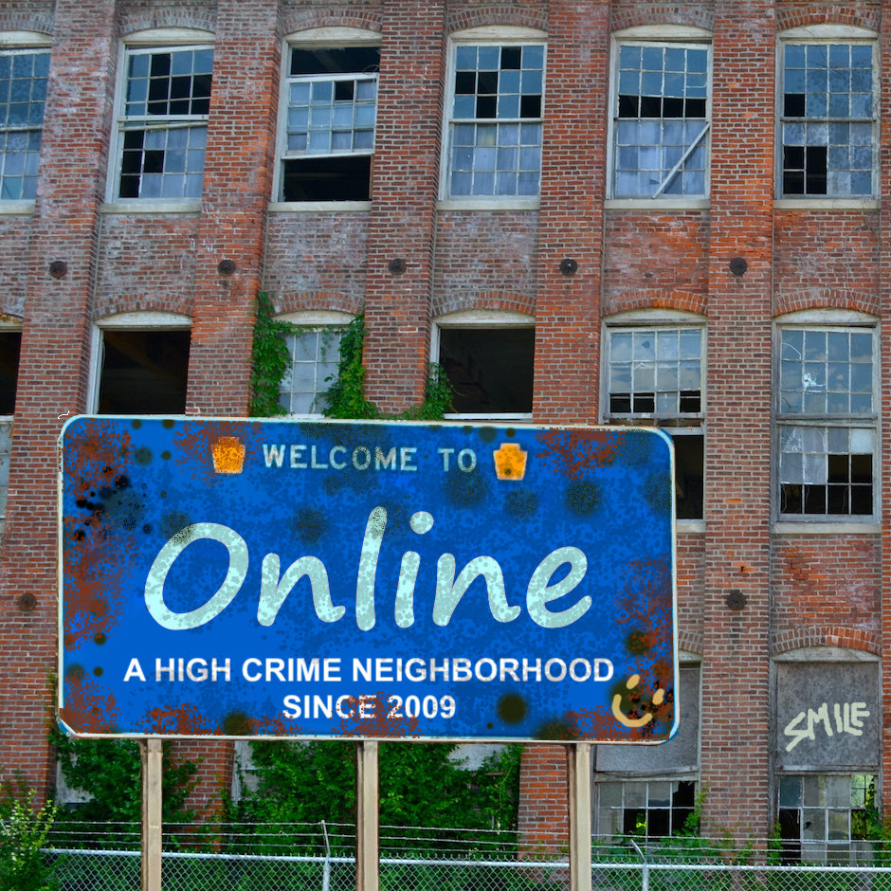
High crime neighborhood characteristics
Frequently visible criminal activity
Visible signs of past crimes
Constant news of new crimes
Constant reminders of crime risks
Lack of effective response from law enforcement
Lack of trust in institutions
Surrounded by ugly, inconvenient anti-crime measures
Welcome to Online
Notes:
The broken windows theory is a criminology theory that suggests that visible signs of disorder and crime can lead to more of the same, including serious crimes. The theory was proposed in 1982 by James Q. Wilson and George Kelling

Slide 25
DISCOVER
DENMARK
Is this text message a scam?
Is this social media post for real?
Is this crypto currency offer legit?
Is it safe to read this PDF attachment?
Why is that apartment rental so cheap?
Is this auction listing a scam?
Is this message really from my bank?
Do I really have to pay a delivery fee?
Where’s my money gone?
Notes:
Online is a stressful place to be

Slide 26
WARNING: This message may be a scam
DISCOVER
DENMARK
Massive breach has exposed millions
Enter digits 2, 4, and 5 of your secret number
NEWS: Huge rise in digital scam losses
Use your other device to confirm your identity
DANGER:
This email may be deceptive
UPDATE NOW to fix security vulnerability
FRAUD ALERT: Are you sure you want to approve this?
Scan face to continue
Notes:
Even the security measures and warnings and awareness add to the stress.

Slide 27
Online: a high crime neighborhood you can’t leave?
If you have a smartphone, email address, or Internet account
You are online, even when you are not online
Being online means digitally savvy criminals can target you, your devices, and your accounts
This threat does not go away when you log off
You can’t move to a safer, less crimey neighborhood
YOU ARE ONLINE

Slide 28
If online is unhealthy and hard to avoid, What are the implications?
An increase in the incentive to reduce cybercrime for:
Governments: improve population health, lower health costs
Organizations: demonstrate social responsibility (CSR)
Consumers: more reasons to avoid, report, seek support
An impact on public policy because requiring or encouraging people to go online creates a duty of care
E.g. In parts of England you now have to use an app to get prescriptions refilled, and must go online to book a blood test
Notes:
Cybercrime causes widespread harm to all.
Cybersecurity failures fuel cybercrime
* Making people go online creates a duty of care, see: https://zcobb.medium.com/do-online-access-imperatives-violate-duty-of-care-19ac155e8857

Slide 29
Chance for cybersecurity research to grab attention
New ways of pressuring governments and companies to do more to reduce cybercrime
New strategies for preventative medicine and population health management that offer measurable ROI
Points to new fields/forms of research
For example: Exposomics, the study of the exposome, the health impact of all the environmental exposures we experience during our life
The exposome includes everything from the air we breathe to diet, lifestyle, workplace
Now includes everything to which you are exposed online

Slide 30
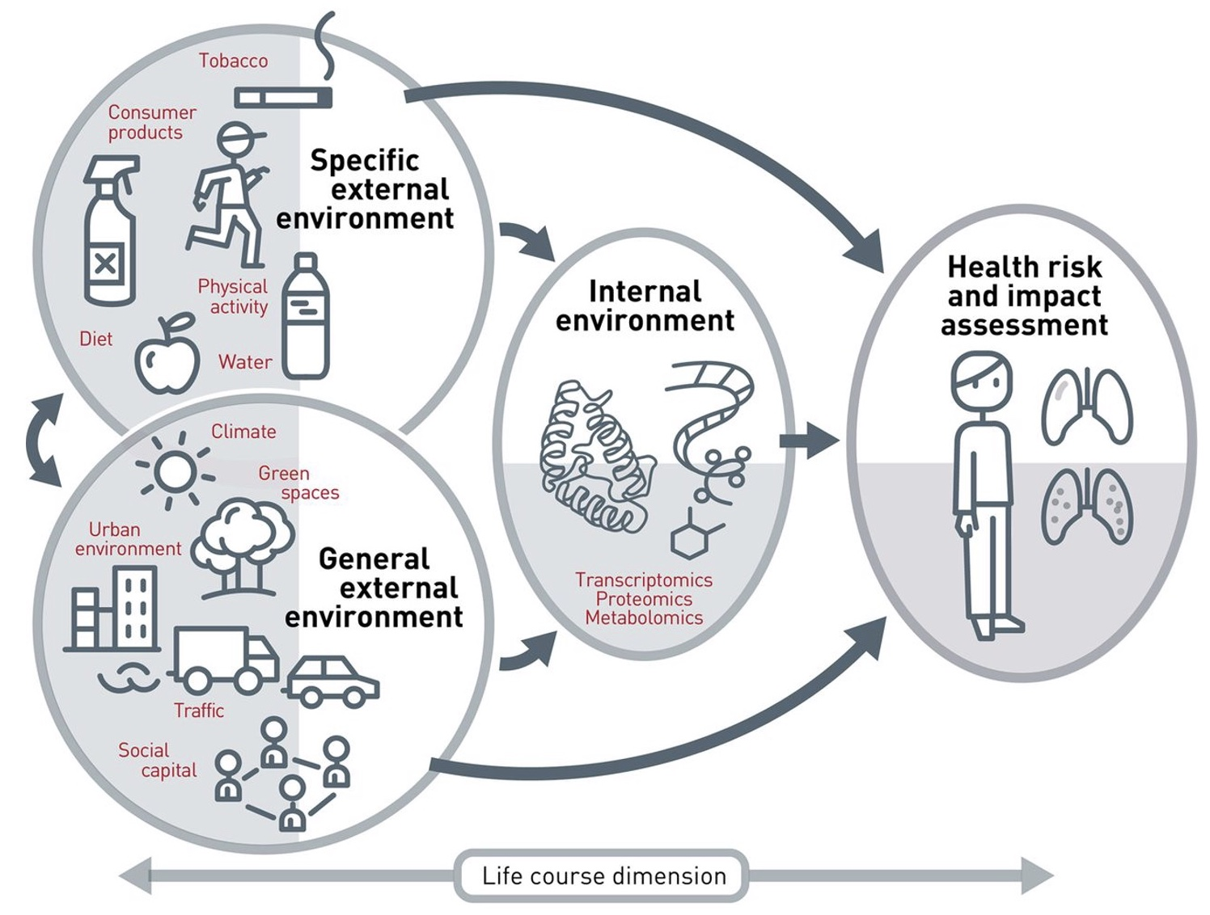
The Exposome Concept
All of the environmental exposures we experience during our life
The exposome includes everything from the air we breathe to diet, lifestyle, workplace, etc.
The exposome originally seen as three inter-related environments
Internal, Specific external, and General External
But now we need to add Online
Notes:
The concept of the exposome illustrated by Martine Vrijheid Research Professor Barcelona Institute for Global Health in Thorax journal, 2014;69:876–878, Copyright © BMJ Publishing Group Ltd & British Thoracic Society. All rights reserved

Slide 31
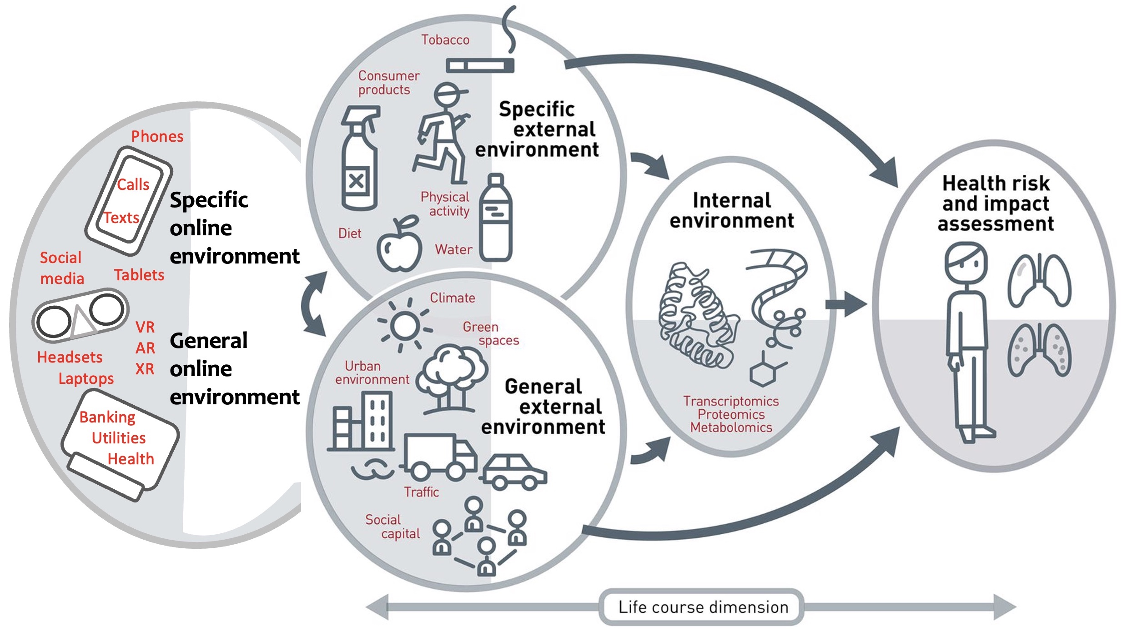
The Online Exposome
Notes:
Based on the concept of the exposome as illustrated by Martine Vrijheid Research Professor Barcelona Institute for Global Health in Thorax journal, 2014;69:876–878, Copyright © BMJ Publishing Group Ltd & British Thoracic Society. All rights reserved.

Slide 32
Research suggestions and approaches
Pursue original research into health impact of cybercrime
Partner with charities, foundations, tech firms, universities, government agencies
Publicize the results, to the benefit of researchers, partners, campaigners, society
Good PR and CSR points for corporate sponsors of research
Make sure results include calls for action, recommendations for reducing impacts

Slide 33
Research can lead to change
Research by Age UK on the extent to which fraud impacts the elderly was used to:
Successfully campaign for mandatory reimbursement for older people that have been scammed via Advanced Push Payment
Research by Which? into fraud’s impact on wellbeing was used to lobby for greater corporate responsibility:
The UK Economic Crime and Corporate Transparency Act 2023 includes a new offense of failure-to-prevent-fraud
Intended to “hold companies to account for fraud occurring on their systems and encourage better corporate behaviours”
Notes:
House of Commons Justice Committee Fraud and the Justice System Fourth Report of Session 2022–23
https://www.skadden.com/insights/publications/2024/09/new-failure-to-prevent-fraud-offence

Slide 34
From research to operations: Dudley, UK
Regional anti-scam campaign, enabled by National Health Service Better Care Fund (NHS - BCF) which funds projects to support people to live healthy, independent and dignified lives
One key objective: enable people to stay well, safe and independent at home for longer
Notes:
https://www.blackcountryradio.co.uk/news/local-headlines/dudley-scams-unit-has-saved-9million-from-falling-into-the-hands-of-financial-criminals/

Slide 35
THE MAIN POINTS
Digital technology has added a new dimension to human existence, the negative health effects of which may outweigh the benefits if we don’t do better at cybersecurity and cybercrime deterrence
Framing crime online as environmental exposure and an issue in population health management opens doors to innovation and funding in cybersecurity, crime reduction, and victim support

Slide 36
Tak! Thank you!
scobb@scobb.net
linktr.ee/StephenCobb
linkedin.com/in/stephencobb
This presentation was aided and abetted by Chey Cobb, author of Network Security for Dummies, and one of the first female presenters at BlackHat
Notes:
In my 1996 whitepaper on Security in e-Commerce, I said “the need to promote ethical behavior in all aspects of business and personal life will remain a priority if we are not to cripple powerful new technology with ancient human weaknesses”

Slide 37
URL for slides and related content:
Slides for this talk: PowerPoint file
Law journal article: Problems with cybercrime metrics
APWG.eu talk: Cybercrime as public health crisis (YouTube)
Dark Reading article: Cybercrime as public health crisis
Medium in-depth article: Duty of care for online access
https://tinyurl.com/cyberharm

